Slide 1
Hepatitis Definitions
Rapid viral response (RVR) | patient with undetectable viral load at week 4 of treatment
Early virologic response (EVR) | patient who experiences at least a 2-log reduction in viral load by the 12th week of treatment (partial EVR) or a patient with undetectable viral load by the 12th week of treatment (complete EVR)
End of treatment response (ETR) | patient with no detectable viral load at the
 | end of treatment
Sustained virologic response (SVR) | patient with no detectable viral load at the conclusion of therapy and 24 weeks (6 months) later
Non-responders | patient with less than a 2-log reduction in viral load after 12 weeks
Partial responder | patient with at least a 2-log reduction in viral load but detectable viral levels after 24 weeks of therapy
Relapsers | patient who responds to therapy but whose viral load becomes detectable once therapy has been discontinued

Slide 2
Hepatitis A:
Highly contagious but not fatal
Transmission | Fecal-Oral Route Contaminated water
Pathophysiology | HAV RNA is ingested → Replicates in hepatocyte Release into billary system (stable b/c no lipid envelope) → elim feces
Diagnosis | Difficult to diagnose b/c usually asymptomatic Anti-HAV: Antibody to HAV
Prophylaxis
Cleanliness | Wash hands, Don’t get uncooked meat
Vaccines | Hep A vaccine as child (in Immunization notes) Havrix, Vaqta
Tx | No chronic liver disease with Hep A and not fatal
None | No tx b/c it is a self limiting disease
Notes:
HAV has no lipid envelope and is stable when excreted from the infected liver to the bile to enter the gastrointestinal tract. It has been found to survive in experimentally contaminated fresh water, seawater, wastewater, soils, marine sediment, live oysters, and creme-filled cookies.

Slide 3
Hep B: General
Transmitted | Body Fluids: Blood, Semen (sex)
Patho (next slide) | HBV is not directly cytopathic; instead it is thought that the immune response to the virus is cytotoxic to hepatocytes.
% Acute Infection | 2%
% Chronic hep b (CHB) | 15%
Anti-HB | Is Lifelong

Slide 4
Hep B Pathophysiology
1. HBV + strand DNA enters
2. Forms cccDNA
3. Produces RNA
4a. RNA → protein:
HbsAg, HbcAg, HbeAg
4b. RNA → - DNA
5. - DNA → + DNA
6. Replicates and exits cell
HBV is not directly cytopathic; instead it is thought that the immune response to the virus is cytotoxic to hepatocytes.

Slide 5
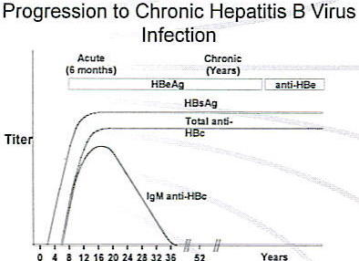
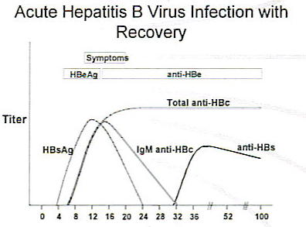
Hep B Diagnosis
Chronic Hep B
HBV DNA > 20,000
Elevated ALT/AST
Chronic & Inactive
HBsAg positive for > 6 months
b/c Hep B antibody is life long
Inactive HBsAg carrier state
HBV DNA < 2,000
Normal ALT/AST

Slide 6
Hep B Tx

Slide 7
Hep B: Prophylaxis, Tx and monitoring
Prophylaxis | Drug | Who
Hep B Vaccine | Recombivax HV Energix-B | All children in US Pts with CKD Healthcare workers
Tx | Drug | Duration
Notes | First line: Entecavir/Tonofovir Search for: Hep B Tx.doc | Indefinite
Monitor | When
HbeAg, HbsAg and HBV DNA | At Start of therapy then q6 months for 1 year then qyear

Slide 8

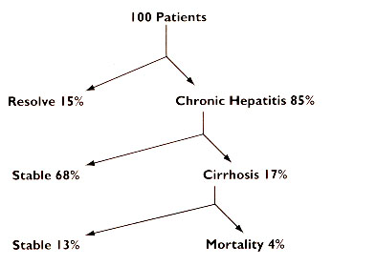
Hep C (HCV):
Transmission | Blood
Progression | Week 2-4 is crucial in determining Genotype Can take 20 – 40 years to cirrhosis Treated when HCV RNA is undetectable 6 months after Tx
Epidemiology | Most Common Worldwide HCV → Cirrhosis → Transplants
Virology | 6 Genotypes Genotype 1 is most resistant (relevant in Tx)

Slide 9
Pathophysiology

Slide 10
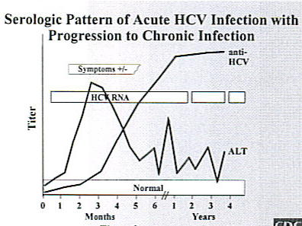
HCV Clinical Course | Usually asymptomatic When acute infection occurs, ALT can be 15x ULN of 50 U/L

Slide 11
HCV Treatment
Check Genotype
Genotype 1
Genotype 2-6
3 Drug Tx b/c Resistance
2 Drug Tx
PEG-IFN
+
Ribavirin
+
Telaprevir or Boceprevir
PEG-IFN
+
Ribavirin

Slide 12
PEG-IFN
Drugs: Pegintron and Pegasys
 | Peg-IFN α2b | Peg-IFN α2a
Brand | Pegitron | Pegasys
Dosing | 1.5 mcg/kg | 180 mcg
Storage | Room Temp | Refrigerated
Contraindications | Decompensated Liver Disease (liver & body) Total Bilirubin > 1.5 INR > 1.7 Ascites Hepatic Encephalopathy | Same as α2b
Side Effects | Flu Like Syndrome, tx NSAIDS/APAP Neutropenia, GSCF as prophylaxis Thrombocytopenia CNS such as depression, anxiety | Same as α2b

Slide 13
Ribavirin
Drug | Ribavirin
Brand | Copegus (tablet) Rebetol (capsule)
Class | Nucleoside analog (DNA)
Contraindications | Pregnancy X Renal Adjustments
Side Effects | Hemolytic Anemia All pts require cardiovascular workup prior to initiation therapy

Slide 14
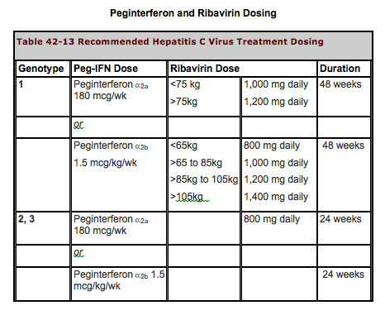
PEG-IFN + Ribavirin

Slide 15
NS3/4A protease inhibitors
 | Boceprevir | Telaprevir
MOA | Inhibit post-translational process | “ “
Brand | Victrelis | Incivek
Dosing | 800 mg TID with food | 750 mg TID with food Food = 20 g fat
Adverse Effects | Anemia → reduce dose Neutropenia → GCSF Thrombocytopenia Dysgeusia → take with milk | Rash → antihistamines, steroids Anemia Anal itching → eat fiber, loperimide
Futility Rule When to stop Tx | Week 4 HCV RNA > 1000 6 months HCV RNA still detectable | “ “
Drug Class | Contraindication
Anticonvulsants | Carbamazepine, Phenobarbital, phenytoin
Antimycobacterials | Rifampin
Ergot derivatives | Dihydroergotamine, methylergonovine
Gi motility agents | Cisapride
HMG CoA reductase inhibitors | Lovastatin, simvastatin, atorvastatin
PDE5 inhibitor | Sildenafil, tadalafil
Sedatives | Triazolam, midazolam
Immunosuppressants | Cyclosporine, tacrolimus
Oral contraception | Ethinyl estradiol- decrease drug exposure. Two effective nonhormonal methods of contraception should be used

